Slide 1
TikTok Shop Market Report:
Cosmetics & Skin Care Category
(2023-2024)
Statistical Period: May 2023-May 2024
EchoTik's official website
EchoTik's official account

Slide 2
CONTENTS
01
Mainstream Market: Analysis of the
Performance and Trend of Beauty & Personal Care
1.The performance of the Beauty & Personal Care category on TikTok Shop in recent year
2.Analysis of the prospect and trend of the Beauty & Personal Care category on TikTok Shop
3.The top 5 popular advertising materials in the mainstream market in recent year
US Market: Analysis of the
Performance and Trend of Beauty & Personal Care
1.The overall performance and trend changes in Beauty & Personal Care in recent year
2.The performance and analysis of excellent Beauty & Personal Care shops
3.The performance and analysis of hot product data
02
03
Thai Market: Analysis of the
Performance and Trend of Beauty & Personal Care
1.The overall performance and trend changes in Beauty & Personal Care in recent year
2.The performance and analysis of excellent Beauty & Personal Care shops
3.The performance and analysis of hot product data
04
Indonesian Market: Analysis of the
Performance and Trend of Beauty & Personal Care
1.The overall performance and trend changes in Beauty & Personal Care in recent year
2.The performance and analysis of excellent Beauty & Personal Care shops
3.The performance and analysis of hot product data
05
Vietnamese Market: Analysis of the
Performance and Trend of Beauty & Personal Care
1.The overall performance and trend changes in Beauty & Personal Care in recent year
2.The performance and analysis of excellent Beauty & Personal Care shops
3.The performance and analysis of hot product data
06
Conclusion
https://echotik.ai

Slide 3
INTROUCTION
DATA EXPLANATION
1. Statistical Period: May 2023 to May 2024
2. Research Object: Analyze the short-video and live-stream e-commerce data in mainstream markets such as the US, Thailand, Indonesia, and Vietnam on TikTok Shop, and select the content related to TikTok and Beauty & Personal Care for analysis and reporting.
3. Data source: Based on the data tracked by the third-party TikTok data analysis platform，EchoTik, not official full-volume data. Based on privacy and data security considerations, the data in this report has been masked.
4. Disclaimer: Due to the limitations of any data source in the field of statistical analysis, the data estimated and analyzed in the report is for reference only.
COPYRIGHT STATEMENT
Except for some content derived from public information, the copyright of other content (including pictures, tables, and text) in this report belongs to EchoTik. The sources of information obtained by EchoTik include but are not limited to public data, market research, etc.
Any use of this data and report must not violate any laws and regulations or infringe the legitimate rights and interests of any third party. Any quotation or citation in any occasion, as well as the reproduction, citation, and publication of the report, must be approved by EchoTik, and the report must not be deleted or modified contrary to the original intention.
This data and report are from EchoTik, and the offender will be investigated for its relevant legal responsibilities.
*For more data, please refer to the official website of EchoTik: https://echotik.ai
https://echotik.ai

Slide 4
Mainstream Market
Analysis of the Performance and Trend of Beauty & Personal Care
1
CHAPTER ONE
https://echotik.ai

Slide 5
Beauty & Personal Care continue to lead the TikTok e-commerce category,
and its GMV has firmly ranked first in recent year.
Among all the categories of TikTok e-commerce, Beauty & Personal Care and womenswear & underwear GMV always occupy the top two positions across all sites. Affected by cultural factors, the GMV ranking of Muslim fashion in Southeast Asia fluctuates greatly, and the sales volume reaches the peak during Ramadan.
Beauty & Personal Care Womenswear & Underwear Health Phones & Electronics Food & Beverages Home Supplies Menswear & Underwear Sports & Outdoor Muslim Fashion Baby & Maternity Household Appliances Fashion Accessories Shoes Luggage & Bags Automotive & Motorcycle Kitchenware Textiles & Soft Furnishings Home Improvement Pet Supplies Collections Furniture Jewellery Accessories & Derivatives Toys & Hobbies Computers & Office Equipment Tools & Hardware Kids' Fashion Books, Magazines & Audio Virtual Products
Beauty & Personal Care Womenswear & Underwear Food & Beverages Muslim Fashion Menswear & Underwear Phones & Electronics Health Baby & Maternity Home Supplies Shoes Luggage & Bags Fashion Accessories Sports & Outdoor Household Appliances Kitchenware Textiles & Soft Furnishings Automotive & Motorcycle Pet Supplies Kids' Fashion Computers & Office Equipment Home Improvement Toys & Hobbies Books, Magazines & Audio Tools & Hardware Furniture Jewellery Accessories & Derivatives Collections Virtual Products
The chart of changes in the GMV ranking of various categories of TikTok e-commerce
https://echotik.ai

Slide 6
The first-mover advantage in Southeast Asia, and the Beauty & Personal
Care category has the leading position in Thailand in terms of annual GMV.
The US market shows strong growth and has become the main battlefield with the highest current GMV.
From the perspective of the absolute value of GMV of the Beauty & Personal Care category in recent year, Thailand ranks first and the US temporarily ranks third. In terms of GMV growth, the US has become the site with the fastest growth rate, and it has become the main selling country with the highest GMV in the past nearly half a year. Among the Southeast Asian markets, Indonesia has been affected by the ban turmoil and has not yet recovered to the best state. Thailand and Vietnam perform better, and both GMV have increased significantly, while other markets maintain steady growth.
GMV (in millions of US dollars) of the Beauty & Personal Care category
in the main selling countries of TikTok in recent year
-Thailand -Indonesia -Vietnam -the Philippines -Malaysia -Singapore -the US -the UK
The GMV trend chart of the Beauty & Personal Care market
(in millions of US dollars)
https://echotik.ai

Slide 7
Live commerce has exploded in the US, with both
market opportunities and intense competition among influencers.
In recent year, the number of shops, the number of influencers, and the number of live-streaming/video e-commerce in various main selling countries of TikTok have all increased exponentially. Among them, the US has the fastest growth rate, which makes it face fierce competition while GMV is growing rapidly. Thailand and Vietnam have relatively large market volumes and a low number of entering influencers, which are good choices for new entrants to do live-streaming e-commerce.
Amount
The current situation of live-streaming e-commerce of
the Beauty & Personal Care category on TikTok in May 2024
the number of influencers
热门市场
Hot market
小众市场
机会市场
Niche Market
Opportunity market
GMV
The trend changes of shops and live-streaming
e-commerce in the Beauty & Personal Care category in recent year
Thailand
Indonesia
Vietnam
The Philippines
The number of shops
2.2 times
The number of influencers
2.2 times
The number of videos
7 times
The number of live-streams
77 times
The number of shops
2.1 times
The number of influencers
2.2 times
The number of videos
5 times
The number of live-streams
83 times
The number of shops
1.8 times
The number of influencers
1.7 times
The number of videos
5 times
The number of live-streams
28 times
The number of shops
1.9 times
The number of influencers
4.0 times
The number of videos 8 times
The number of live-streams
63 times
Malaysia
Singapore
The US
The UK
The number of shops
2.1 times
The number of influencers
2.4 times
The number of videos
6 times
The number of live-streams
43 times
The number of shops
3.2 times
The number of influencers
2.9 times
The number of videos
5 times
The number of live-streams
36 times
The number of shops
125 times
The number of influencers
4.6 times
The number of videos
265 times
The number of live-streams
598 times
The number of shops
3.1 times
The number of influencers
2.1 times
The number of videos
4 times
The number of live-streams 32 times
https://echotik.ai

Slide 8
More than 20,000 Beauty & Personal Care shops in Indonesia
and Thailand, and the highest proportion of cross-border shops in Singapore.
From the perspective of the changing trend of the number of shops in the Beauty & Personal Care category, all countries maintain a growth trend. At present, the number of shops in Indonesia and Thailand, which have the highest number, has exceeded 20,000. From the perspective of the category of shops, local policies in Indonesia restrict the opening of cross-border shops, and the proportion of cross-border shops in Singapore is the highest, reaching 40%. The main reason for this situation is related to the local operating costs.
The growth trend of the number of shops in the Beauty & Personal Care
category in various main selling countries in recent year
The distribution of the types of active shops in the Beauty & Personal Care
category in various main selling countries
Thailand
Indonesia
Vietnam
The
Philippines
Cross-border shop 8%
Cross-border shop 0
Cross-border shop 6%
Cross-border shop 12%
Malaysia
Singapore
The US
The UK
Cross-border shop 11%
Cross-border shop 40%
Cross-border shop 9%
Cross-border shop 15%
https://echotik.ai

Slide 9
The scale of influencers in various countries maintains a growth
trend, and the number of fans of top influencers exceeds 5 million.
From the perspective of the changing trend of the number of influencers in the Beauty & Personal Care category, all countries maintain a growth trend. Among them, the US and the Philippines have the highest increments, and the current number of influencers has exceeded 130,000. Most of the influencers in various countries are at the level of less than 100,000 fans, but there have also been top influencers with more than 5 million fans.
The growth trend of the number of influencers in the Beauty & Personal Care
category in various main selling countries in recent year
The distribution of the fan magnitude of associated influencers in the
Beauty & Personal Care category in recent year (w means 10k)
 | Thailand | Indonesia | Vietnam | The Phillipines | Malaysia | Singapore | The US | The UK
0-10w | 96.5% | 93.8% | 94.4% | 97.5% | 98.2% | 99.3% | 94.6% | 93.8%
10-100w | 3.4% | 6.0% | 5.5% | 2.4% | 1.7% | 0.7% | 5.3% | 6.0%
100-500w | 0.11% | 0.21% | 0.13% | 0.08% | 0.01% | 0 | 0.18% | 0.21%
500-1000w | 0 | 0.002% | 0 | 0.001% | 0 | 0 | 0.002% | 0.002%
>1000w | 0 | 0 | 0 | 0 | 0 | 0 | 0 | 0
https://echotik.ai

Slide 10
Short-video e-commerce remains the mainstream e-commerce
method, and short videos under 30 seconds are the most popular.
For various countries, short videos are all mainstream e-commerce methods, and the number of Beauty & Personal Care-related e-commerce videos is steadily increasing. From the perspective of video duration, creators tend to produce and release short videos of 15 to 30 seconds. From the perspective of release time, 12-21 o'clock is the peak period for short video releases, and Vietnam has a double peak at 12 o'clock and 19 o'clock.
The growth trend of the number of associated live broadcasts in the
Beauty & Personal Care category in various main selling countries in recent year
The growth trend of the number of Beauty & Personal Care-related
e-commerce videos in various main selling countries in recent year
The distribution of the duration of Beauty & Personal Care-related videos in May 2024
The distribution of the release time of Beauty & Personal Care-related videos in May 2024 (local time)
0-6a.m.
7-12a.m.
13-18p.m.
19-24p.m.
https://echotik.ai

Slide 11
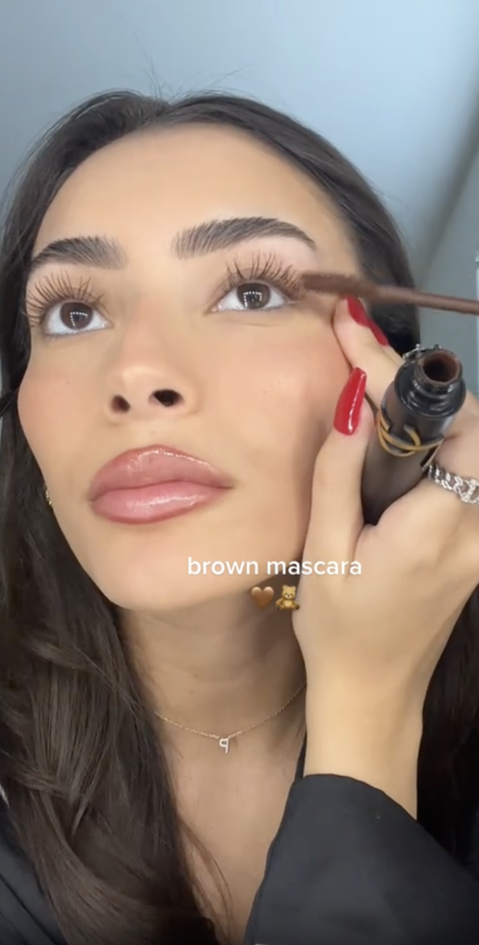
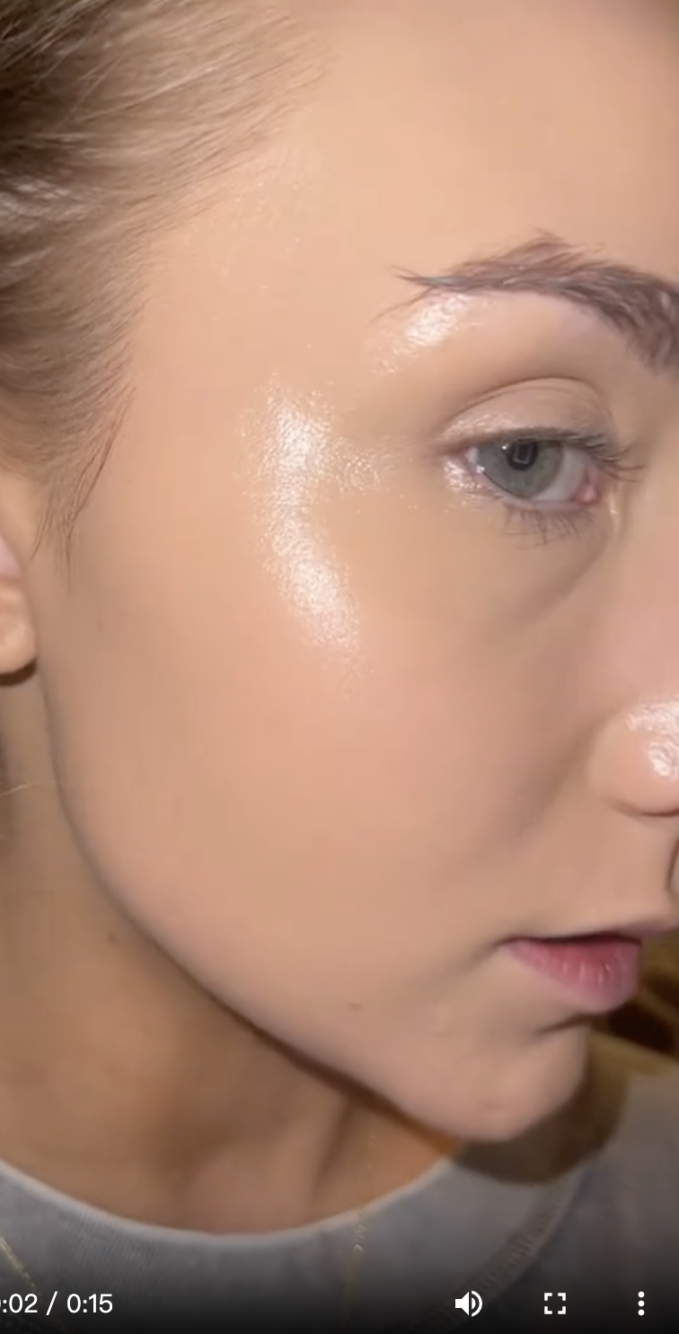
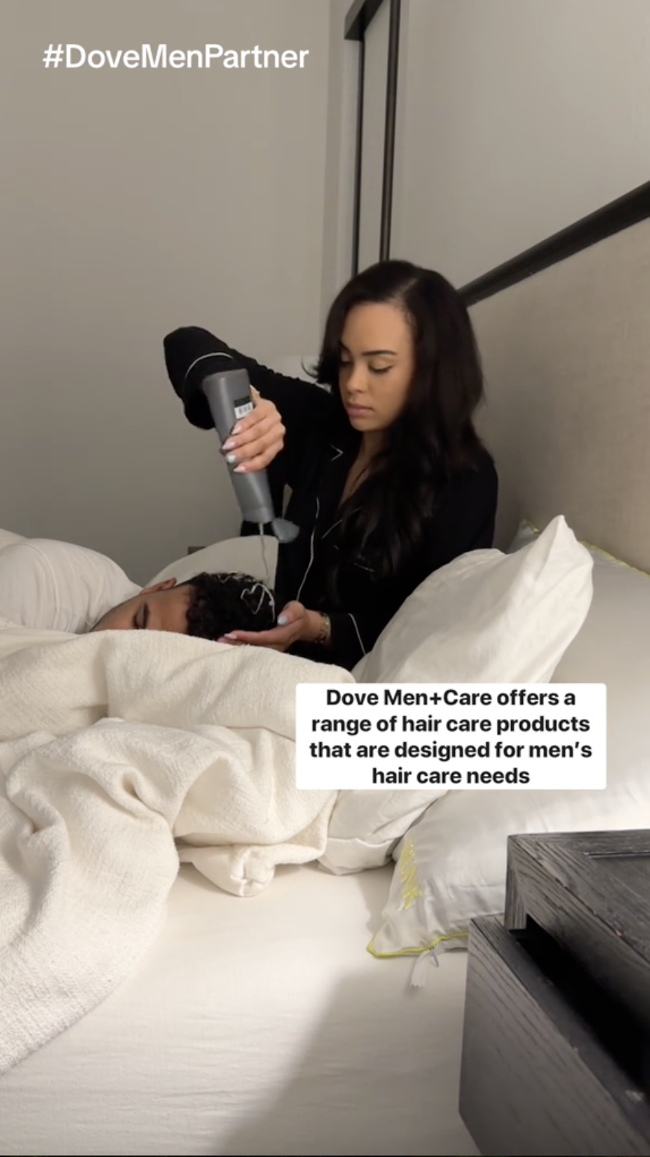
US market
Top 5 Beauty & Personal Care video ads in recent year (sorted by estimated impressions)
Advertiser：Sephora
Channel: TikTok Displayed product: Brown mascara
Estimated impressions: 328M Video duration: 8 seconds
Launch time: 2024-02-17 ~ 2024-02-17
Content: The influencer demonstrates the coloring effect and the effect of lengthening and thickening the eyelashes of the brown mascara.
Advertiser：Ulta Beauty
Channel: TikTok Displayed product: Sunscreen foundation
Estimated impressions: 194.1M Video duration: 15 seconds
Launch time: 2024-02-21 ~ 2024-03-13
Content: The influencer's oral broadcast + shows the poreless and natural
skin effect after applying the foundation.
Advertiser：the urban gadget
Channel: YouTube Displayed product: Multipurpose razor
Estimated impressions: 112.1M Video duration: 32 seconds
Launch time: 2023-08-22 ~ 2024-05-19
Content: Through humorous shots to show the multiple functions of the razor.
Advertiser：MikMak
Channel: TikTok Displayed product: Men's shampoo
Estimated impressions: 111.3M Video duration: 44 seconds
Launch time: 2023-11-25 ~ 2023-11-29
Content: On the bed in the dead of night, the wife washes the husband's hair. Grabs the eye through an absurd scene.
Advertiser：Amazon
Channel: YouTube Displayed product: Black whitening toothpaste
Estimated impressions: 105.6M Video duration: 15 seconds
Launch time: 2022-02-10 ~ 2024-06-09
Content: After the customer uses the whitening toothpaste, she can't help but take out her mobile phone to take a selfie with the toothpaste and toothbrush.
Data source: BigSpy - The world's leading overseas advertising SPY tool https://bigspy.com/
Statistical time: June 2023 - June 2024
https://echotik.ai

Slide 12
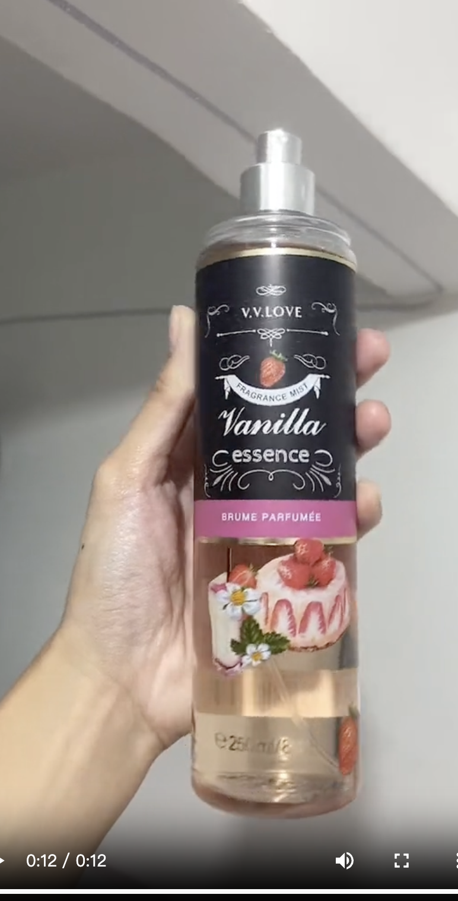
Southeast Asian market
Top 5 Beauty & Personal Care video ads in recent year (sorted by estimated impressions)
Advertiser：L'Oréal
Channel: YouTube Displayed product: Men's oil-control facial cleanser
Estimated impressions: 126.5M Video duration: 15 seconds
Launch time: 2024-02-15 ~ 2024-02-29
Content: Product promotion discount information, combined with oral introduction.
Advertiser：Skull Shaver
Channel: YouTube Displayed product: Electric hair clipper
Estimated impressions: 123.8M Video duration: 15 seconds
Launch time: 2023-11-01 ~ 2023-12-01
Content: The picture of the electric hair clipper scraping over the human head and scratching over the skull model.
Advertiser：pantene
Channel: YouTube Displayed product: Shampoo
Estimated impressions: 116.1M Video duration: 44 seconds
Launch time: 2024-02-07 ~ 2024-02-29
Content: After the long-haired man uses the shampoo, his hair instantly becomes refreshing and smooth, full of a sense of humor.
Advertiser：the urban gadget
Channel: YouTube Displayed product: Multipurpose razor
Estimated impressions: 112.1M Video duration: 32 seconds
Launch time: 2023-08-22 ~ 2024-05-19
Content: Through humorous shots to show the multiple functions of the razor.
Advertiser：marianneymt
Channel: TikTok Displayed product: Body spray
Estimated impressions: 112M Video duration: 12 seconds
Launch time: 2024-02-29 ~ 2024-02-29
Content: Product display, combined with music.
Data source: BigSpy - The world's leading overseas advertising SPY tool https://bigspy.com/
Statistical time: June 2023 - June 2024
https://echotik.ai

Slide 13
Commodity sales and GMV price segment differentiation: In developing countries, sales are concentrated in the 0-10 dollar range, the Philippine market is the most depressed one, and Singapore is the most suitable for selling high-priced products.
The sales situation and supply situation in various countries are relatively consistent, and sales in developing countries are more concentrated in 0-10 dollar commodities;
The highest GMV commodities in the United States and the United Kingdom are in the 20-30 dollar range, and in Singapore, it is above 100 dollars.
Proportion of the number of goods in each price tier
in the Beauty & Personal Care category in recent year
Proportion of sales in each price tier
in the Beauty & Personal Care category in recent year
Proportion of GMV in each price tier
in the Beauty & Personal Care category in recent year
https://echotik.ai

Slide 14
US Market
Analysis of the Performance and Trend of Beauty & Personal Care
2
CHAPTER TWO
https://echotik.ai

Slide 15
After half a year of explosive growth,
the current growth momentum in the US market tends to be stable.
The categories with the highest GMV in the US TikTok market are: Beauty & Personal Care, womenswear & underwear, and health. The overall trend of the top is relatively weak, and the top three categories account for about 42% of the GMV of all and other categories.
Each first-level category shows a multiple increase during the shopping peak season in the third and fourth quarters of 2023. The growth slows down in the first half of 2024 and tends to be stable.
GMV (in millions of dollars) of each
first-level category in the TikTok US market in recent year
The bimonthly sequential growth rate of each
first-level category in the TikTok US market in recent year
 | 2023.7 | 2023.9 | 2023.11 | 2024.1 | 2024.3 | 2024.5
Beauty & Personal Care | 2576.85% | 529.54% | 166.88% | -23.70% | 24.54% | -15.04%
Womenswear & Underwear | 1178.91% | 214.80% | 153.67% | 7.85% | -2.55% | -23.83%
Health | 51252.82% | 1576.14% | 825.23% | -5.33% | 51.00% | 49.71%
Collections | 1242.22% | 224.55% | 304.89% | 75.13% | 15.83% | -54.55%
Sports & Outdoor | 754.95% | 357.92% | 627.88% | -1.54% | 2.99% | -17.75%
https://echotik.ai

Slide 16
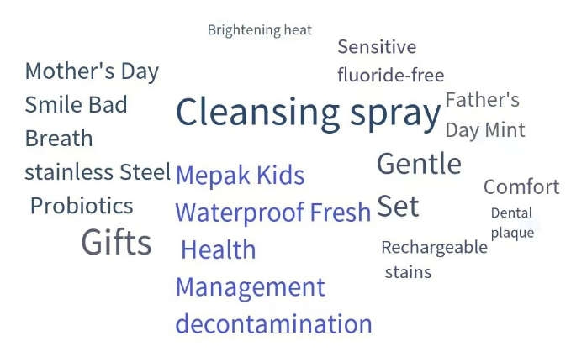
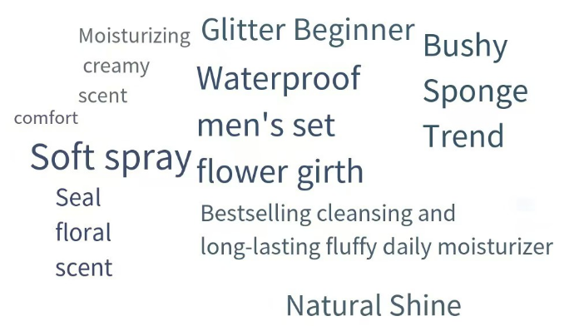
American consumers have a preference for nose and oral
care, and more segmented market demands await to be developed.
From the perspective of the secondary categories of Beauty & Personal Care, different from other national markets that pay more attention to basic skin care, American consumers pay the most attention to nose and oral care. For nose and oral care, American consumers value teeth whitening and oral cleaning the most.
Makeup and perfume, and skin care products rank second and third among the secondary categories respectively, and the top three account for about 84%. It is worth noting that from the perspective of keywords, the skin care and beauty needs of men have received the attention of many consumers in the US market.
GMV distribution of secondary categories
of Beauty & Personal Care in the US market
Nasal & Oral Care
Makeup & Perfume
https://echotik.ai

Slide 17
The GMV of the top 10 shops is more than 1.6 million dollars
Natural vegan ingredients and no animal testing are the selling points of the hot-selling brands.
The GMV of the top 1 shop in the US Beauty & Personal Care category is about 5 million dollars, and the gap between other shops is not obvious, with the GMV ranging from 1.6 million to 2.6 million dollars. Among the top 10 shops, all shops are local shops. Eight shops mainly sell Beauty & Personal Care categories, and the GMV accounts for about 90%. The proportion of the Beauty & Personal Care category in the total store sales of other shops is about 45% to 70%.
Among the top 10 stores, brands that claim to use natural vegan ingredients account for the majority; the environmentalism that the brand advocates not using animal testing in the historical origin and entrepreneurial concept has also gradually become the focus of consumers' attention.
Top 10 stores in the Beauty & Personal Care category in May 2024
Store name | Type | Number of products (piece) | Sales volume (thousand pieces) | GMV (US dollars) | Proportion of Beauty & Personal Care in the total store sales
Tarte Cosmetics | Local | 75 | 124.01 | 5.33M | 91.32%
Cocomint Beauty | Local | 109 | 120.81 | 2.59M | 99.16%
Jeffree Star Cosmetics | Local | 153 | 169.29 | 1.90M | 67.50%
Herfessmartlife | Local | 8 | 66.11 | 1.82M | 99.03%
Gopure | Local | 32 | 69.08 | 1.81M | 99.28%
simplymandys | Local | 46 | 98.79 | 1.78M | 88.01%
The Beachwaver | Local | 108 | 40.01 | 1.75M | 45.47%
wavytalk | Local | 9 | 77.90 | 1.72M | 99.59%
ONE SIZE BEAUTY | Local | 32 | 71.22 | 1.71M | 98.24%
The Ordinary Store | Local | 68 | 146.19 | 1.62M | 97.89%
https://echotik.ai

Slide 18
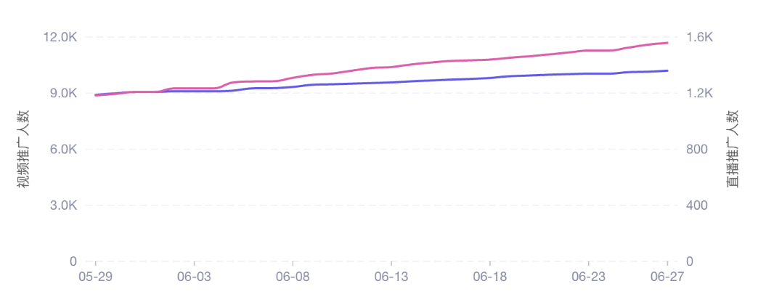
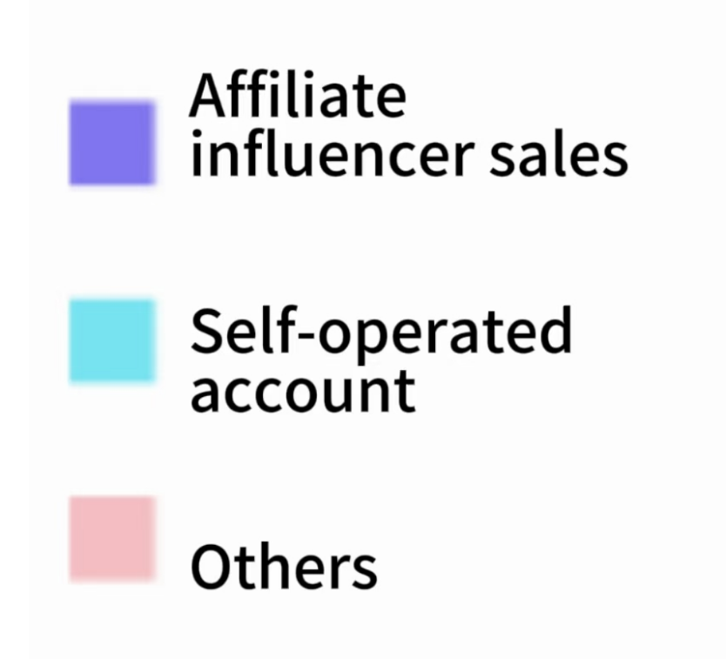
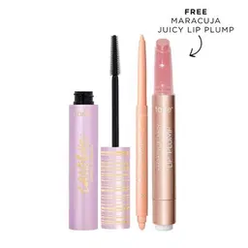
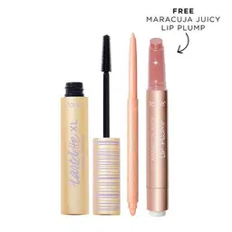
Analysis of shops in the US market
TOP 1：Tarte Cosmetics
Tarte Cosmetics is an American makeup brand established in 1999, with North America as the market center. The Kose Group acquired it nine years ago as part of its globalization strategy. Nowadays, this brand has already become the revenue pillar of the group's makeup sector. After entering the TikTok local shop in 2023, Tarte Cosmetics often ranks at the top. On TikTok, the product prices of this brand range from $11 to $68, and the average price is $29.06. The main sales method is video promotion with goods, with 11.2k associated influencers, 34.3k videos, and 7.3k live broadcasts. The shop mainly promotes cosmetic sets and meets the needs of customers through combination products of different prices and types.
Distribution of sales channels
Related Influencers Trend
Top 3 best-selling products in the recent 30 days
Cosmetic set
Price: $39.00 30-day sales volume: 24.3k
Number of influencers: 969
Steady growth in product sales
Cosmetic set
Price: $27.30 30-day sales volume: 6.4k
Number of influencers: 239
Sales continue to increase, but the growth rate slows down.
Cosmetic set
Price: $31.00 30-day sales volume: 4.9k
Number of influencers: 323
High dependence on promotion, and low sales volume during non-promotion periods.
https://echotik.ai

Slide 19
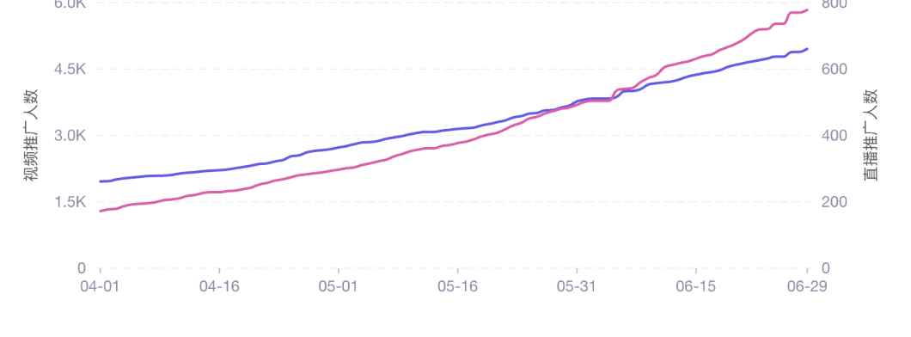
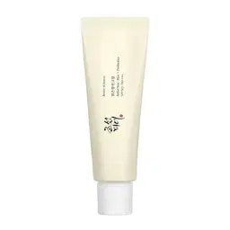
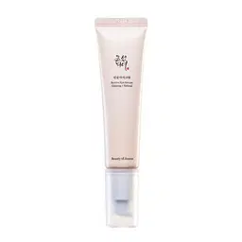
Analysis of shops in the US market
TOP 2：Cocomint Beauty
Cocomint Beauty was founded in 2015 by Jane Collins, who is a skincare enthusiast passionate about natural and sustainable beauty products. Due to the natural ingredients and the concept of environmentally friendly skincare, it has received the attention of consumers from many countries and regions in Europe, America and Asia. This brand mainly sells through online channels, and offline mainly through the layout of collection stores and channel shops to increase product awareness.
On TikTok, the product prices range from $3.49 to $69.99, and the average price is $20.60. The main sales method is video promotion with goods, with 5.5k associated influencers, 11.2k videos, and 3.4k live broadcasts. In the transaction amount of the shop, the proportion of influencer promotion with goods is relatively high, and the associated influencers have increased by about 3 times in the past three months.
Distribution of sales channels
Related Influencers Trends
Top 3 best-selling products in the recent 30 days
Facial mask
Price: $25.57 Number of influencers: 1.1k
30-day sales volume: 56.1k
The sales growth trend has slowed down in the recent month.
Sunblock
Price: $15.89 Number of influencers: 211
30-day sales volume: 16.6k
The total sales in the past six months have steadily increased.
Eye essence
Price: $10.79 Number of influencers: 95
30-day sales volume: 5.2k
The total sales in the past six months have steadily increased.
https://echotik.ai

Slide 20
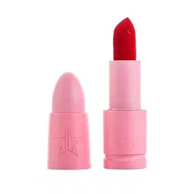
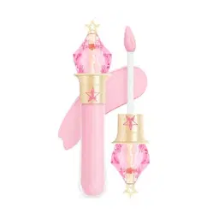
Analysis of shops in the US market
TOP 3：Jeffree Star Cosmetics
Jeffree Star Cosmetics was founded in 2014 by the beauty blogger Jeffree Star. The product prices range from $2.10 to $308.00, and the average price is $40.93. The main sales method is video promotion with goods, with 490 associated influencers, 899 videos, and 427 live broadcasts. Recently, the shop has created the highest single-day sales volume of 148.3k through the method of live broadcasts by top influencers to promote with goods.
Top 3 best-selling products in the recent 30 days
Single-color eyeshadow
Price: $2.10 Number of influencers: 31
30-day sales volume: 75.8k
Created a sales volume of 18.2k in a single live broadcast.
Lipstick
Price: $20.00 Number of influencers: 75
30-day sales volume: 30.6k
The top influencer created a sales volume of 1.6k in a single live broadcast.
Concealer
Price: $25.00 Number of influencers: 88
30-day sales volume: 9.2k
The top influencer created a sales volume of 1.4k in a single live broadcast.
https://echotik.ai

Slide 21
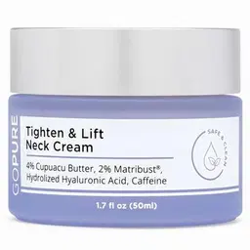
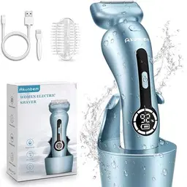
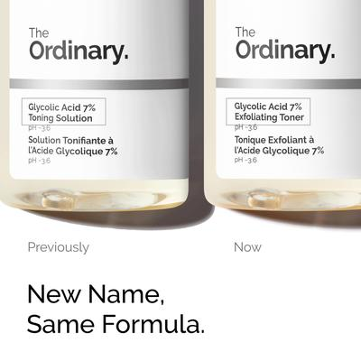
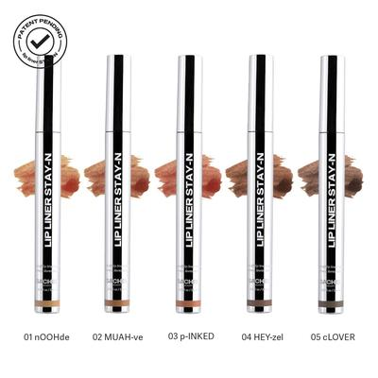
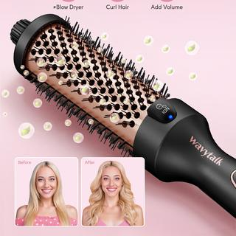
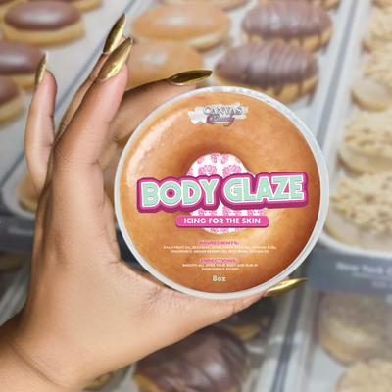
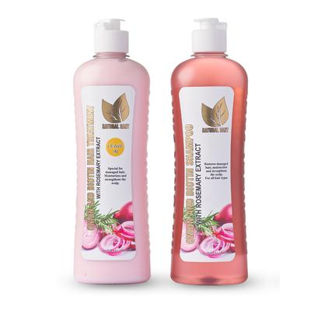
US market
Top 10 best-selling products in the Beauty & Personal Care category in May 2024
Rank | Product |  | Price | Sales volume | Sales amount | Number of influencers | Number of videos
1 |  | Sungboon Editor - Deep Collagen Anti-Wrinkle Lifting Mask | $28.74 | 62.84k | 1.70M | 620 | 790
2 |  | GOPURE Neck Cream - Tighten & Lift Firming Neck Cream for Crepey Skin | $23.40 | 59.15k | 1.50M | 2498 | 2680
3 |  | tarte™ best-sellers trending trio | $22.00 | 44.24k | 1.22M | 1145 | 1111
4 |  | Neck Shoulder Back Massager with Heat - Shiatsu Massager Adjustable Relaxing Gift Plug-in Comfort | $24.49 | 53.88k | 1.18M | 697 | 711
5 |  | Akunbem Electric Shaver for Women Best Electric Razor for Womens Bikini Legs Underarm Public | $20.22 | 63.37k | 1.15M | 844 | 934
6 |  | Glycolic Acid 7% Exfoliating Toner | $10.85 | 100.6k | 1.09M | 938 | 1130
7 |  | LIP LINER STAY-N - PEEL-OFF LIP LINER TATTOO | $16.14 | 66.79k | 1.06M | 1126 | 1428
8 |  | Wavytalk Negative Ion Single Thermal brush 1.5 Inch | $19.98 | 37.70k | 903.1k | 706 | 878
9 |  | (NEW) BODY GLAZE: Pick your scent! | $17.50 | 51.67k | 894.5k | 1074 | 1382
10 |  | Onion, Biotin and Rosemary Shampoo & Treatment Set for Stronger, Thicker and Longer Hair - Soft and Shine, Hair Loss and Thinning Hair | $12.50 | 40.14k | 693.7k | 1384 | 1491
https://echotik.ai

Slide 22
Thai Market
Analysis of the Performance and Trend of Beauty & Personal Care
3
CHAPTER THREE
https://echotik.ai

Slide 23
The Thai Beauty & Personal Care category shows fluctuating growth, accounting for about 25% of the total GMV of the first-level category.
The categories with the highest GMV in the Thai TikTok market are: Beauty & Personal Care，Womenswear & Underwear and Health. Among them, Beauty & Personal Care is in a leading position, occupying 25% of the GMV of all first-level categories; each first-level category shows seasonal fluctuating growth, and the Beauty & Personal Care category has a tendency to decline after 3 months of continuous growth.
GMV (in millions of dollars) of each first-level category
in the TikTok Thai market in recent year
The bimonthly sequential growth rate of each first-level category
in the TikTok Thai market in recent year
 | 2023.7 | 2023.9 | 2023.11 | 2024.1 | 2024.3 | 2024.5
Beauty & Personal Care | -57.78% | -15.38% | -10.48% | 29.43% | 31.46% | -10.49%
Womenswear & Underwear | 52.02% | -22.96% | 84.68% | 21.84% | 4.22% | -23.12%
Muslin Fashion | 67.85% | -2.77% | 24.50% | 14.38% | 11.22% | -2.72%
Menswear & Underwear | 40.20% | -31.53% | -10.34% | 32.22% | 9.14% | -0.16%
Phones & Electronics | 53.71% | -18.05% | 0.35% | 32.59% | 2.79% | 18.95%
https://echotik.ai

Slide 24
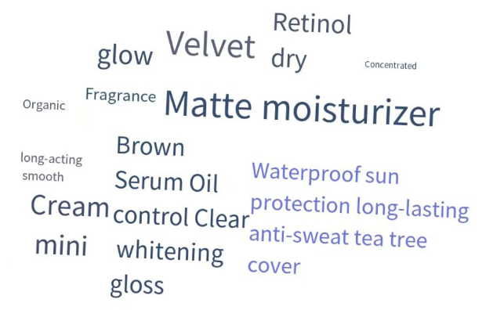
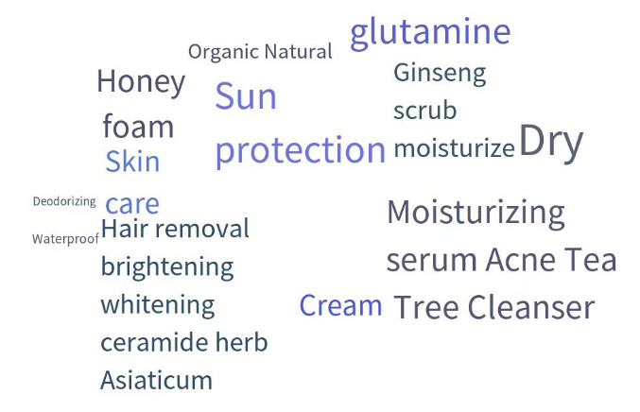
Thai consumers have the highest preference for makeup and perfume, and pay the most attention to water resistance and durability.
Among the second-level categories of Beauty & Personal Care, Thai consumers have the highest preference for makeup and perfume, with a GMV share of approximately 45%, significantly leading other second-level categories; for cosmetics, Indonesian consumers pay the most attention to water resistance and durability, followed by moisturizing and sunscreen effects.
GMV distribution of the second-level category
of Beauty & Personal Care in the Thai market
Makeup & Perfume
Bath & Body Care
https://echotik.ai

Slide 25
The threshold of the GMV of the Top 10 stores in the Thai Beauty & Personal Care category is 800,000 dollars, and local shops account for 80%.
The head effect of shops in the Thai Beauty & Personal Care category is relatively weak. The GMV of the Top 1 shop is about 2 million dollars, and the GMV of the Top 2 to Top 10 shops are all around 1 million dollars. The overall gap is relatively small, and the head effect has not yet occurred.
Among the top 10 shops, the top eight are all local shops, and 7 shops mainly sell in the Beauty & Personal Care category, and the GMV accounts for more than 80%.
Top 10 stores in the Beauty & Personal Care category in May 2024
Name | Type | Number of products | Sales volume (thousand pieces) | GMV （$） | Proportion of Beauty & Personal Care in the total store sales
korich | Local | 60 | 214.33 | 2.03M | 90.12%
drpongshop | Local | 140 | 167.78 | 1.36M | 65.48%
Madamefin | Local | 81 | 84.64 | 1.30M | 87.70%
Chaba168 | Local | 58 | 53.22 | 1.08M | 100.00%
DKskinshop เครื่องสำอาง | Local | 563 | 274.02 | 1.07M | 87.61%
Swisslab Thailand | Local | 88 | 43.19 | 955.38k | 81.17%
SkintificThailand | Local | 80 | 66.61 | 939.08k | 100.00%
คำแน้ม | Local | 2 | 92.84 | 905.27k | 100.00%
CHILLAB THAILAND | Cross-border | 14 | 32413 | 879.02k | -
WOSADO.TH | Cross-border | 31 | 13674 | 861.25k | -
https://echotik.ai

Slide 26
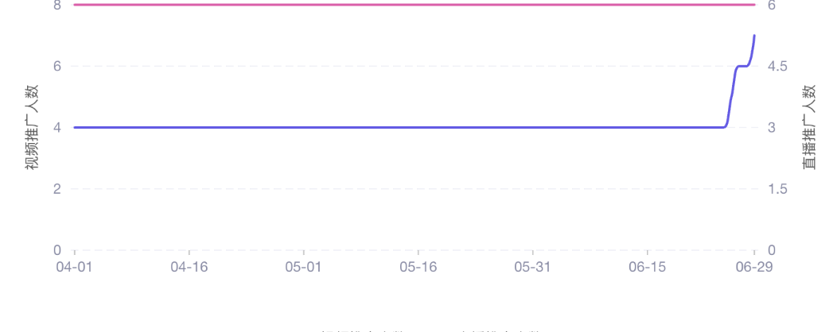
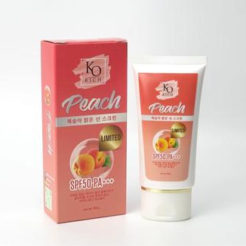
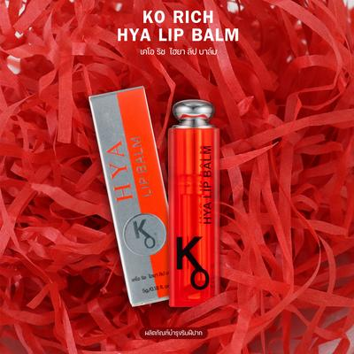
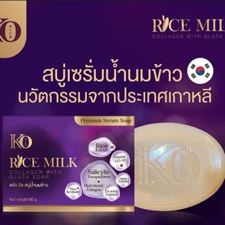
Thai market
TOP 1：ELFORMULA ID
The product prices range from ฿2.93 to 498.49K, and the average price is ฿3.09K. The main sales method is video promotion with products, with 10 associated influencers, 451 videos, and 123 live broadcasts. The top 1 best-selling product in the shop started video promotion in the last month and thus drove the sales growth.
Distribution of sales channels
Related Influencers Trends
Top 3 best-selling products in the recent 30 days
Shampoo + conditioner
Price: ฿323.37 Number of influencers: 2
30-day sales volume: 32.4k
Video promotion in the recent 1 month drives the sales.
Lip balm
Price: ฿105.72 Number of influencers: 2
30-day sales volume: 21.7k
The overall sales volume shows a downward trend in the recent 3 months.
Bath soap
Price: ฿339.83 Number of influencers: 2
30-day sales volume: 18.3k
Video promotion in the recent 1 month drives the sales.
https://echotik.ai

Slide 27
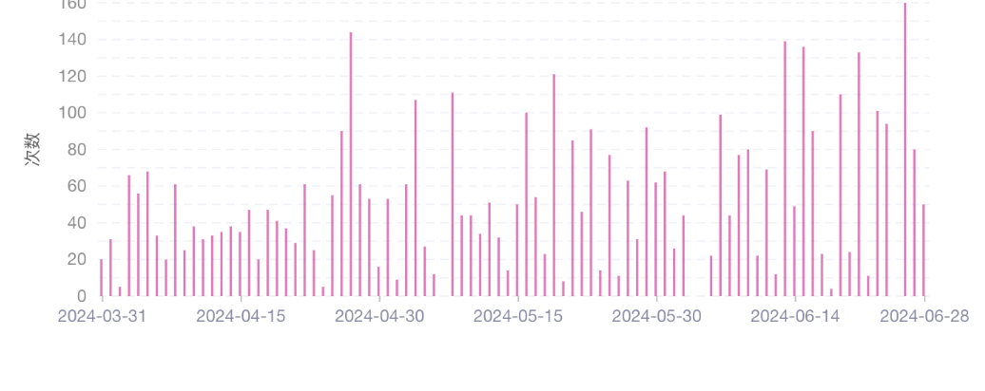
Thai market
TOP 2：drpongshop
The product prices range from ฿24.87 to 3.45K, and the average price is ฿423.96. The main sales method is video promotion with goods, with 3.7k associated influencers, 11.7k videos, and 6.3k live broadcasts. In addition to the Beauty & Personal Care category, the health category has a relatively high sales proportion in this shop, and there is a health category product among the best-selling products.
Distribution of sales channels
Related Videos Trends
Top 3 best-selling products in the recent 30 days
Concealer
Price: ฿167.17 Number of influencers: 54
30-day sales volume: 29.1k
The sales volume in the last month has steadily increased.
Dietary supplement
Price: ฿377.51 Number of influencers: 76
30-day sales volume: 19.1k
The product sales volume is highly correlated with the number of videos.
Essence
Price: ฿369.46 Number of influencers: 67
30-day sales volume: 17.2k
The increase in videos drives the rapid growth of sales volume.
https://echotik.ai

Slide 28
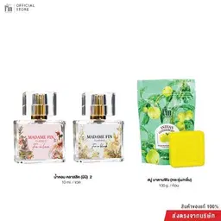
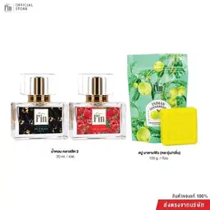
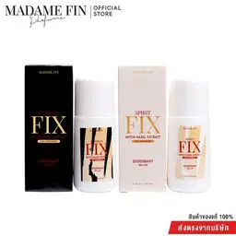
Thai market
TOP 3：Madamefin
The product prices range from ฿61.82 to ฿2.55K, and the average price is ฿768.91. The main sales method is video promotion with goods, with 2.4k associated influencers, 11.8k videos, and 5.0k live broadcasts. This shop mainly sells perfume, and the recent sales volume shows a downward trend.
90-day sales trend chart of the shop
Top 3 best-selling products in the recent 30 days
Perfume + soap
Price: ฿395.43 Number of influencers: 66
30-day sales volume: 10.6k
Sold with soap.
Perfume + soap
Price: ฿990.22 Number of influencers: 56
30-day sales volume: 4.8k
Sold with soap.
Body spray
Price: ฿276.91 Number of influencers: 16
30-day sales volume: 2.5k
The sales volume has decreased due to the reduction of promoting videos in the last month.
https://echotik.ai

Slide 29
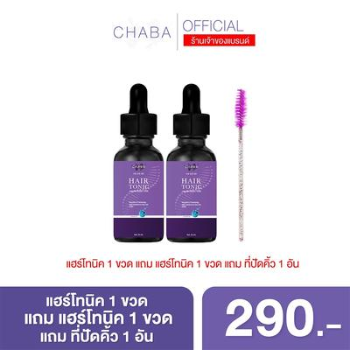
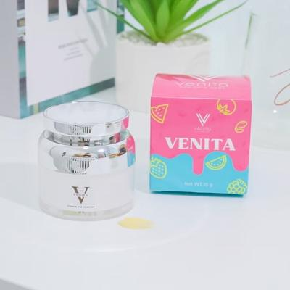
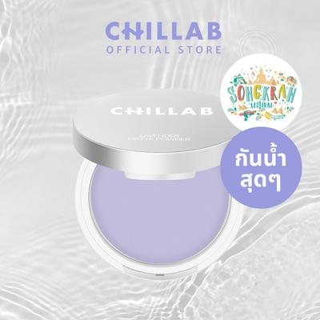
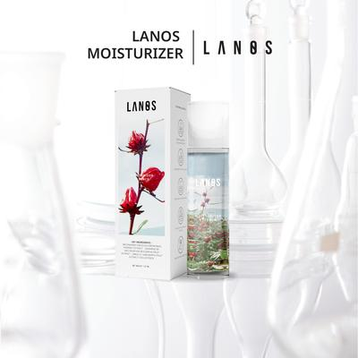
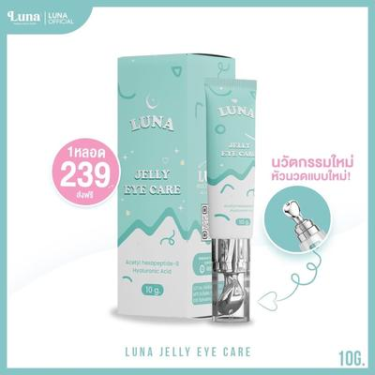
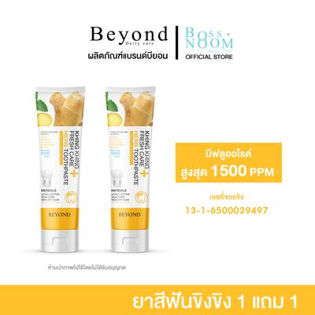
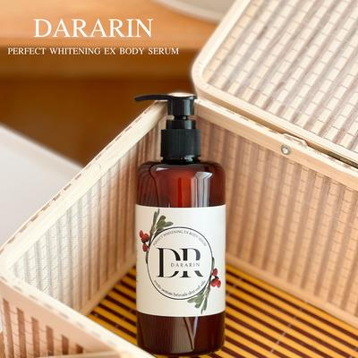
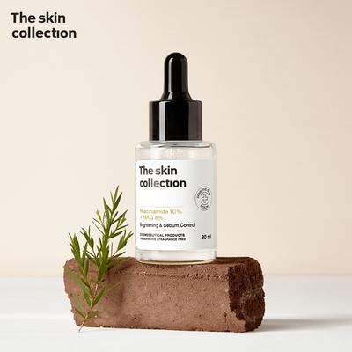
Thai market
Top 10 best-selling products in the Beauty & Personal Care category in May 2024
Rank | Product |  | Price | Sales volume | Sales amount | Number of influencers | Number of videos
1 |  | แฮร์โทนิค 1 ขวด (35 ml.) แถมที่ปัดคิ้ว 1 อัน โทนิคเซรั่ม เหมาะสำหรับผู้ที่อยากมีผม หนวด คิ้ว ปลูก ส่งฟรี | $23.26 | 41.45k | 972.4k | 186 | 555
2 |  | [บริษัทโดยตรง] สูตรใหม่ Ela Rae อีล่าแรร์ ครีมทารักแร้ แพคเก็จใหม่ | $10.08 | 92.77k | 903.4k | 186 | 644
3 |  | ครีมเมริโกะ ครีมบำรุงผิว ให้ความชุ่มชื้น | $5.43 | 117.6k | 870.2k | 679 | 1661
4 |  | ครีมเวนิตา 15กรัม ผิวทุกประเภท Skincare | $26.77 | 25.84k | 644.5k | 31 | 82
5 |  | CHILLAB Lavender Matte Powder - แป้งม่วงควบคุมความมัน 1ตลับ 2ตลับ 3ตลับ 10g ผิวมัน with puff | $13.77 | 30.22k | 503.5k | 119 | 214
6 |  | น้ำตบลานอส Moisturizer Essenc | $20.38 | 21.82k | 444.3k | 407 | 922
7 |  | ลูน่าอายครีมLUNA JELLY EYE CARE 10 g. (หัวนวดเก็บความเย็น) | $15.52 | 27.00k | 423.4k | 242 | 486
8 |  | ยาสีฟันขิงขิง แบรนด์บียอน - โปรโมชั่น ซื้อ 1 หลอด แถมฟรี 1 หลอด | $18.36 | 20.79k | 380.1k | 99 | 256
9 |  | DARARIN Perfect Whitening EX Body Serum 250 ml | $5.41 | 59.70k | 372.4k | 1239 | 357
10 |  | The Skin Collection Serum Niacinamide10% + NAG8% เซรั่มสำหรับคนที่มีปัญหารอยดำรอยแดง 30ml | $3.77 | 84220 | 318.2k | 2111 | 754
https://echotik.ai

Slide 30
Indonesian Market
Analysis of the Performance and Trend of Beauty & Personal Care
4
CHAPTER FOUR
https://echotik.ai

Slide 31
Beauty & Personal Care accounts for about 22% of the total GMV,
and currently the GMV has exceeded that before the ban incident.
The highest GMV categories in the Indonesian TikTok market are: Beauty & Personal Care, womenswear & underwear, and Muslim fashion. The top three categories account for about 50% of the GMV of all and other categories. After the ban incident, all categories have grown rapidly. Although the GMV of Beauty & Personal Care has recently dropped, it has already exceeded that before the shops were taken down.
GMV (in millions of US dollars) of each first-level category
in the TikTok Indonesian market in the recent year
The bimonthly sequential growth rate of each first-level category
in the TikTok Indonesian market in recent year
 | 2023.7 | 2023.9 | 2023.11 | 2024.1 | 2024.3 | 2024.5
Beauty & Personal Care | 17.07% | -44.45% | - | - | 43.33% | -5.81%
Womenswear & Underwear | 28.18% | -48.04% | - | - | 40.72% | -16.82%
Muslin Fashion | 19.14% | -44.71% | - | - | 142.68% | -61.83%
Menswear & Underwear | 40.92% | -44.06% | - | - | 80.23% | -47.43%
Phones & Electronics | 8.70% | -4.72% | - | - | 47.20% | 0.76%
https://echotik.ai

Slide 32
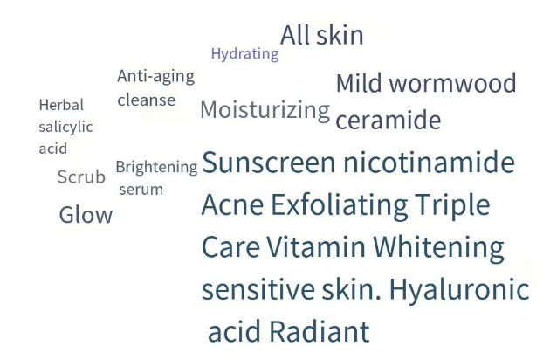
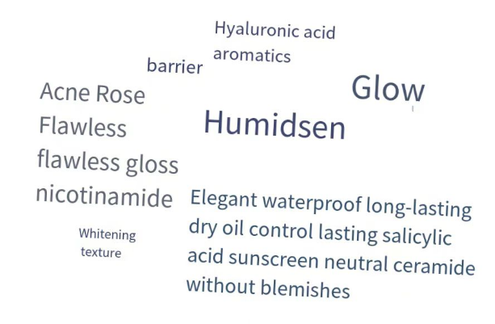
Indonesian consumers have the greatest preference for skin care
products, mainly emphasizing sun protection and moisturizing effects.
Among the second-level categories of Beauty & Personal Care, Indonesian consumers have the greatest preference for skin care products, makeup, and perfume, and the GMV ratio of the two accounts for about 74%;
For skin care products, Indonesian consumers value the sun protection effect the most, and for cosmetics, they value the waterproof effect the most.
GMV distribution of the second-level category
of Beauty & Personal Care in the Indonesian market
Skincare
Makeup & Perfume
https://echotik.ai

Slide 33
Indonesian market
The threshold of the top 10 stores in the GMV of Beauty & Personal Care is about 900,000.
Seventy percent of the shops mainly focus on the sales of the Beauty & Personal Care category.
The GMV of the top two shops exceeds 7 million dollars, which is far ahead of the store ranked third in a fault-like manner. The GMV accounts for about 20% of the overall Beauty & Personal Care market in Indonesia, and the head effect is obvious;
Among the top 10 shops, seventy percent of the shops mainly focus on the sales of the Beauty & Personal Care category, and the GMV ratio exceeds 80%, while the proportion of the Beauty & Personal Care category in the total store sales of other shops is about 38% to 58%.。
Top 10 stores in the Beauty & Personal Care category in May 2024
Name | Type | Number of products | Sales volume (thousand pieces) | GMV （$） | Proportion of Beauty & Personal Care in the total store sales
ownerdavienaskincare | Local | 78 | 202.23 | 7.80M | 89.66%
Glafidsya Skincare | Local | 363 | 51.77 | 7.16M | 38.56%
ELFORMULA ID | Local | 15 | 216.19 | 1.99M | 100.00%
Bella Shofie Dabe | Local | 179 | 112.18 | 1.53M | 58.13%
SSSKIN ID | Local | 122 | 43.26 | 1.52M | 38.23%
H&H Skincare | Local | 355 | 62.47 | 1.29M | 80.14%
The Originote | Local | 55 | 380.29 | 1.12M | 100.00%
ONLYOU Store | Local | 98 | 140.52 | 940.74k | 87.04%
Maybelline Indonesia | Local | 95 | 124.55 | 915.00k | 90.06%
facetologystore | Local | 36 | 151.00 | 888.46k | 84.27%
https://echotik.ai

Slide 34
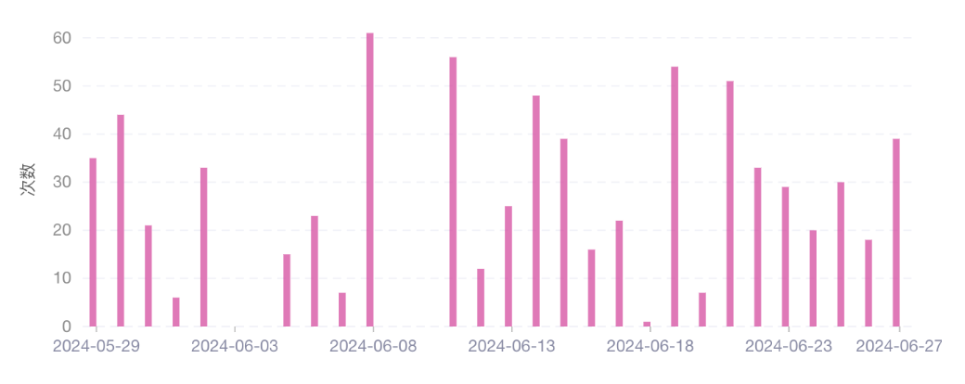
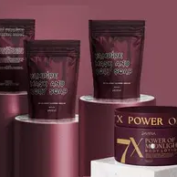
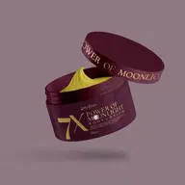
Indonesian market
TOP 1：ownerdaviena skincare
The product prices range from Rp37.43K to Rp24.28M, and the average price is Rp906.26K. The main sales method is video promotion with goods, with 1.7k associated influencers, 6.9k videos, and 5.0k live broadcasts. The popular products in this shop are all related to one product, either sold in a package with other products or split into different specifications for sale.
Distribution of sales channels
Related Videos Trends
Top 3 best-selling products in the recent 30 days
Essence + body lotion
Price: Rp622.43k Number of influencers: 1
30-day sales volume: 21.4k
Sold in a package of the hot product.
Body lotion
Price: Rp487.34k Number of influencers: 1
30-day sales volume: 19.8k
The hot product is split into different specifications for sale.
Body lotion
Price: Rp243.67k Number of influencers: 13
30-day sales volume: 19.4k
Live promotions have started to decrease since summer.
https://echotik.ai

Slide 35
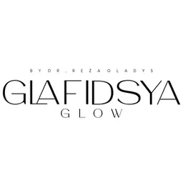
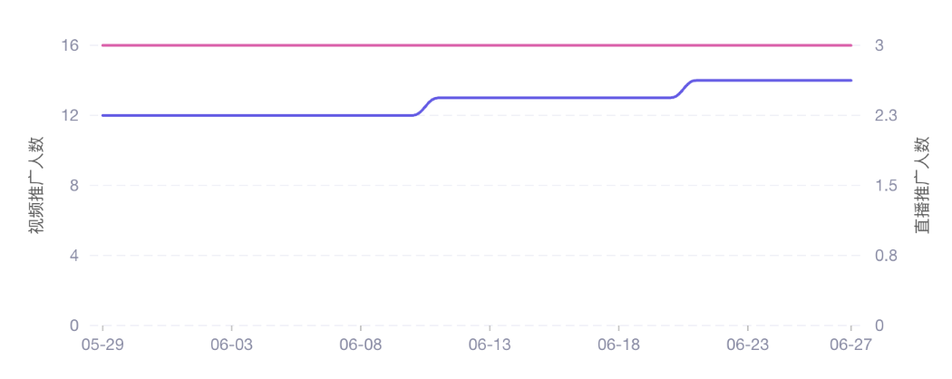
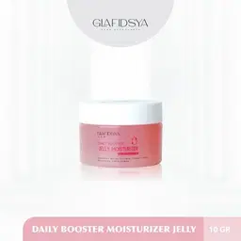
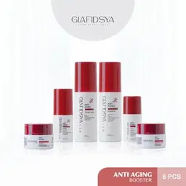
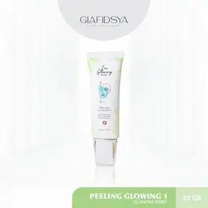
Indonesian market
TOP 2：Glafidsya Skincare
The product prices range from Rp31.00K to Rp416.56M, and the average price is Rp3.27M. The main sales method is video promotion with goods, with 15 associated influencers, 50 videos, and 272 live broadcasts. The sales amount of the influencers only accounts for 8% of the overall sales amount. Hot products are associated with 0 influencers, and it does not rely on the influencers to promote goods.
Distribution of sales channels
Related Influencers Trends
Affiliate influencer sales8%
Self-operated account1%
Top 3 best-selling products in the recent 30 days
Moisturizing face cream
Price: Rp1.95M Number of influencers: 0
30-day sales volume: 4.9k
Continuously popular in the store.
Skin care set
Price: Rp5.01M Number of influencers: 0
30-day sales volume: 3.4k
Steadily shipping continuously.
Exfoliating cream
Price: Rp1.07M Number of influencers: 0
30-day sales volume: 2.1k
Performed excellently in the recent month.
https://echotik.ai

Slide 36
Indonesian market
TOP3：ELFORMULA ID
The product prices range from Rp60.72K to Rp407.51K, and the average price is Rp142.80K. The main sales method is video promotion with goods, with 3.0k associated influencers, 8.7k videos, and 2.3k live broadcasts. The sales volume of the top 1 product in this shop is far ahead, thereby driving the sales of other products in the shop.
Distribution of sales channels
Related Videos Trends
Top 3 best-selling products in the recent 30 days
Exfoliating essence
Price: Rp111.31k Number of associated videos: 1.4k
30-day sales volume: 115.2k
Has been on the market for a long time, and the sales are stable for a long time.
Exfoliating essence + moisturizing face cream
Price: Rp233.87k Number of associated videos: 810
30-day sales volume: 46.1k
A set of exfoliating essence and moisturizing face cream.
Moisturizing face cream
Price: Rp125.13k Number of associated videos: 602
30-day sales volume: 26.4k
Has been on the market for a long time, and the sales are stable for a long time.
https://echotik.ai

Slide 37
Indonesian market
Top 10 best-selling products in the Beauty & Personal Care category in May 2024
Rank | Product |  | Price | Sales volume | Sales amount | Number of influencers | Number of videos
1 |  | ( DAPAT 100 PAKET RESELLER ) BODY LOTION POWER MOONLIGHT DAVIENA SKINCARE | $1.55K | 0.90k | 1.39M | 11 | 12
2 |  | ( DAPAT 100) PAKET RESELLER[ [SLEEPING MASK RETINOL BOOSTER | RETINOL BOOSTER ] | $1.49K | 0.90k | 1.33M | 3 | 3
3 |  | GLAFIDSYA - DAILY BOOSTER MOISTURIZER JELLY | $118.1 | 9.16k | 1.07M | 0 | 0
4 |  | ELFORMULA Intensive Peeling Solution - Serum Exfoliating Dark Spot Eksfoliasi Wajah Berminyak Mencerahkan Kusam dan Mengangkat Sel Kulit Mati dan Kotoran | $7.96 | 133.3k | 1.04M | 606 | 1211
5 |  | ( Dapat 100 ) Vampire Mask And Body Soap | DAVIENA SKINCARE | $803.1 | 1.00k | 806.8k | 2 | 2
6 |  | ( DAPAT 3) SLEEPING MASK RETINOL BOOSTER | DAVIENA SKINCARE | $44.63 | 17.55k | 781.2k | 70 | 112
7 |  | ELFORMULA Bundle 2in1 - Peeling Serum + Barrier Moisturizer Gel | $14.87 | 48.33k | 701.8k | 265 | 670
8 |  | [ BMG PABRIK ] PAKET 2 LOTION MALAM KUNING DAN 2 BODY NIGHT CREAM BPOM ORIGINAL | $4.41 | 136.7k | 663.4k | 518 | 2425
9 |  | [BELI 2 GRATIS HADIAH] Maybelline Superstay Matte Ink Liquid Matte Lipstick Waterproof Make Up Transferproof Tahan 16 Jam | $6.05 | 87.71k | 512.4k | 320 | 1150
10 |  | ( DAPAT 3 ) Vampire Mask And Body Soap | DAVIENA SKICARE | $24.09 | 21.05k | 506.2k | 20 | 21
https://echotik.ai

Slide 38
Vietnamese Market
Analysis of the Performance and Trend of Beauty & Personal Care
5
CHAPTER FIVE
https://echotik.ai

Slide 39
The beauty and personal care category in Vietnam accounts for 22% of
the total GMV of the first-level category, with an 85% year-on-year growth in May.
The highest GMV categories in the Vietnamese TikTok market are: beauty and personal care, women's clothing, and men's clothing. The top three categories account for approximately 51% of the GMV of all first-level categories.The growth of each first-level category is affected by the season. The GMV of the beauty and personal care category grew at a relatively fast rate in the first quarter and is currently in a state of decline.
GMV (in millions of US dollars) of each first-level category
in the TikTok Vietnamese market in the recent year
The bimonthly sequential growth rate of each first-level category
in the TikTok Vietnamese market in recent year
 | 2023.7 | 2023.9 | 2023.11 | 2024.1 | 2024.3 | 2024.5
Beauty & Personal Care | 49.72% | -25.63% | 22.12% | 56.50% | 45.06% | -40.21%
Womenswear & Underwear | 55.65% | -43.25% | 95.24% | 95.99% | -13.31% | -57.43%
Health | 53.37% | -33.13% | 73.48% | 119.30% | -25.97% | -49.00%
Collections | 7.18% | -38.00% | 16.27% | 95.43% | 3.55% | -12.07%
Sports & Outdoor | 37.89% | -17.29% | 37.12% | 68.13% | 1.39% | -34.39%
https://echotik.ai

Slide 40
Vietnamese consumers have the greatest preference for skin care products and pay attention to skin problems and skin care.
Among the second-level categories of Beauty & Personal Care, the attention of Thai consumers is relatively scattered. They have the greatest preference for skin care products, with a GMV share of approximately 34%, followed by makeup and perfume, with a GMV share of approximately 21.0%;
For skin care products, Indonesian consumers pay the most attention to the effects of sun protection and moisturizing. In addition, they are more concerned about skin problems such as acne.。
The GMV distribution of the second-level category
of Beauty & Personal Care in the Vietnamese market
Skincare
Makeup & Perfume
https://echotik.ai

Slide 41
Vietnamese market
The threshold of the top 10 stores in the GMV of Beauty & Personal Care is about 400,000.
Seventy percent of the shops mainly focus on the sales of the Beauty & Personal Care category.
The GMV of the top 4 shops in the Beauty & Personal Care category in Thailand is around 1 million dollars, and there is a significant gap for the last six stores, with the GMV ranging from 4 million to 7 million dollars;
Among the top 10 shops, 9 are local shops. 7 shops mainly focus on the sales of the Beauty & Personal Care category, and the GMV ratio exceeds 90%. The proportion of the Beauty & Personal Care category in the total sales of other shops is approximately 30% to 60%.
Top 10 stores in the Beauty & Personal Care category in May 2024
Name | Category | Number of products | Sales volume (thousand pieces) | GMV （$） | Proportion of Beauty & Personal Care in the total store sales）
eHerb Viet Nam | Local | 53 | 325.69 | 1.31M | 99.96%
COLORKEY Việt Nam | Local | 89 | 137.11 | 1.04M | 100.00%
HASAKI BEAUTY | Local | 1623 | 147.60 | 1.03M | 93.41%
GMEELAN Beauty Store | Local | 83 | 144.52 | 909.05k | 47.46%
MYLAI SKIN SHOP | Local | 486 | 30.27 | 697.41k | 61.63%
Carslan.VN | Cross-border | 36 | 55.00 | 496.94k | 99.85%
DrCung Store | Local | 196 | 31.31 | 489.25k | 29.43%
Thế Giới Skinfood Store | Local | 1275 | 89.17 | 453.83k | 99.35%
L'oreal Paris Việt Nam | Local | 190 | 44.15 | 447.58k | 100.00%
TMV MAILISA | Local | 29 | 12.79 | 444.90k | 100.00%
https://echotik.ai

Slide 42
Vietnamese market
TOP 1：Tarte Cosmetics
The product prices range from ₫13.50K to ₫471.62K, and the average price is ₫128.42K. The main sales method is video promotion with goods, with 3.3k associated influencers, 7.7k videos, and 6.0k live broadcasts. This shop mainly sells body sprays and adopts a discount strategy to promote sales.
Distribution of sales channels
Related Influencers Trends
Top 3 best-selling products in the recent 30 days
Body spray
Price: ₫91.73k Number of influencers: 123
30-day sales volume: 120.8k
The sales volume has steadily increased in the recent 3 months.
Body spray
Price: ₫137.33k Number of influencers: 183
30-day sales volume: 96.0k
The sales volume has steadily increased in the recent 3 months.
Body spray
Price: ₫59.88k Number of influencers: 18
30-day sales volume: 42.0k
The sales volume has steadily increased in the recent 3 months.
https://echotik.ai

Slide 43
Vietnamese market
TOP 2：COLORKEY Việt Nam
The product prices range from ₫20.64K to ₫806.93K, and the average price is ₫344.48K. The main sales method is video promotion with goods, with 1.0k associated influencers, 2.5k videos, and 2.5k live broadcasts. In the recent month, this shop relied on high-density videos on a single day to drive a sudden increase in daily sales, and subsequently promoted the overall sales.
Distribution of sales channels
Related Videos Trends
Top 3 best-selling products in the recent 30 days
Mask
Price: ₫140.14k Number of influencers: 73
30-day sales volume: 52.4k
The sales volume has increased driven by video promotion of goods in the recent month.
Foundation
Price: ₫99.12k Number of influencers: 0
30-day sales volume: 45.8k
The sales volume growth has accelerated in the recent month.
Mask
Price: ₫198.23k Number of influencers: 63
30-day sales volume: 17.2k
The sales volume growth has accelerated in the recent month.
https://echotik.ai

Slide 44
Vietnamese market
Top 3：HASAKI BEAUTY
The product prices range from ₫1.53K to ₫3.47M, and the average price is ₫298.87K. The main sales method is video promotion with goods, with 2.0k associated influencers, 3.2k videos, and 5.1k live broadcasts. The top 1 best-selling product in the store mainly relies on the sudden sales increase on a single day to boost the overall sales.
Distribution of sales channels
Related Videos Trends
Top 3 best-selling products in the recent 30 days
Sunscreen
Price: ₫154.15k Number of influencers: 8
30-day sales volume: 18.0k
The sudden sales increase on a single day boosts the overall sales to 8.7k.
Makeup remover
Price: ₫125.36k Number of influencers: 18
30-day sales volume: 12.6k
The main promotion method is live promotion of goods.
Shower gel
Price: ₫75.93k Number of influencers: 6
30-day sales volume: 10.2k
The main promotion method is live promotion of goods.
https://echotik.ai

Slide 45
Vietnamese market
Top 10 best-selling products in the Beauty & Personal Care category in May 2024
Rank | Product |  | Price | Sales volume | Sales amount | Number of influencers | Number of videos
1 |  | Body Mist Unisex Phù Hợp Hẹn Hò, Đi Chơi - Xịt Thơm Toàn Thân Nam & Nước Hoa Nữ Thơm Lâu BODYMISS Perfume Cosmetic Có hoa Women 105ml (Chai) | $4.84 | 126.5k | 620.6k | 235 | 459
2 |  | Body Mist Unisex - Xịt Thơm Toàn Thân Nước Hoa Cho Nam & Nữ Phù Hợp Đi Học, Đi Chơi Hẹn Hò BODYMISS Perfume Cosmetic Women Mỹ Phẩm 30ml - 105ml (Chai) | $3.39 | 113.5k | 387.5k | 157 | 326
3 |  | GMEELAN Kem Dưỡng Nách Sakura Underarm Cream 30g Kem hỗ trợ dưỡng sáng nách | $5.06 | 48.22k | 258.2k | 100 | 124
4 |  | Body mist Lưu Hương Lâu Chính Hãng Cho Nam Nữ Unisex, Bodymist Thơm Lâu Body Cho Học Sinh Sinh Viên Chai Lớn & Nhỏ - BODYMISS Perfume Cosmetic Nước Hoa Xịt Thơm | $2.31 | 75.04k | 233.1k | 103 | 199
5 |  | 【COD】GMEELAN ORANGE EXFOLIATING GEL 50g Tẩy Tế Bào Chết Da Mặt Skincare | $4.67 | 46.87k | 229.1k | 97 | 104
6 |  | {Combo 6 sản phẩm} 2 Lọ Sữa Tắm Tía Tô SACHIMY(800ml 1 lọ); 1 lọ dung dịch tía tô trầu không;1 lọ dung dịch tía tô hoa bưởi;1 lọ dung dịch tía tô nano bạc; 1 nước hoa vk. | $12.05 | 24.97k | 227.3k | 164 | 343
7 |  | N3 - BỘ SẢN PHẨM KEM DƯỠNG DOCTOR MAGIC HỖ TRỢ CẢI THIỆN TÌNH TRẠNG DA NÁM, TÀN NHANG, ĐỒI MỒI Skincare Dưỡng Ẩm Da | $82.41 | 2.11k | 195.2k | 0 | 0
8 |  | Máy mát xa cầm tay toàn thân 6 cấp độ . | $5.01 | 34.55k | 173.6k | 60 | 222
9 |  | Kem Body Miss Thái Lan Hỗ Trợ Dưỡng Da Body 170g | $9.18 | 16.23k | 171.16k | 63 | 114
10 |  | Kem Dưỡng Thể Hỗ Trợ Dưỡng Sáng Da - Oshirma White Body Butter Cream 200G | $13.65 | 10.67k | 170.2k | 15 | 34
https://echotik.ai

Slide 46
SUMMARY
As the world's leading social media platform TikTok, the entire e-commerce field has shown great market potential on the platform. And the Beauty & Personal Care category, as the category that has long ranked first in GMV, is not only one of the top choices for many sellers to join TikTok, but also a barometer of the market popularity of TikTok Shop.
From the demand side, the Beauty & Personal Care category ranks first in all major sales countries. Judging from the absolute value of GMV in the Beauty & Personal Care category in the past year, Thailand ranks first. But in terms of GMV growth, the United States has become the fastest-growing site and is currently the major sales country with the highest GMV of Beauty & Personal Care.
From the supply side, live promotion with goods has exploded in the United States. In the past year, the number of shops, videos and live broadcasts has increased exponentially. From the overall competitive landscape, the US market has both opportunities and competition. Thailand and Vietnam have a relatively large market size and a low number of participating influencers, and are good choices for new entrants to promote with goods.
In terms of the price and sales tiers, the Beauty & Personal Care markets are divided into two tiers. In developing countries, both the sales volume and sales amount of goods are concentrated within the range of 0-10 dollars, among which the Philippine market is the most down-market; in developed countries, the highest sales amount of goods in the UK and the US is in the range of 20-30 dollars, while the highest price range of sales amount in Singapore is above 100 dollars, which is suitable for promoting high-unit-price goods.
The US market has experienced explosive growth for half a year, and the current growth trend has stabilized. Among the second-level categories, the most preferred products by consumers are nose and oral care products, but the best-selling stores mainly sell cosmetics, and the head effect is not obvious in shops.
In the Southeast Asian market, the GMV of the Beauty & Personal Care category in Thailand, Indonesia and Vietnam accounts for about 25% of the overall TikTok Shop. In terms of growth trends, Indonesia has been affected by the ban turmoil and has not yet recovered to its best state. Thailand and Vietnam perform well, and the GMV has increased significantly. Other markets maintain steady growth. Among the second-level categories, consumers in Southeast Asia generally have a greater preference for skin care products, makeup and perfume.
https://echotik.ai

Slide 47
New Assistance for E-commerce
About EchoTik
6
CHAPTER SIX
https://echotik.ai

Slide 48
Why choose EchoTik？
As a professional TikTok e-commerce data SaaS service provider, EchoTik adheres to the core concepts of professionalism, focus, and innovation. The team has in-depth research on the TikTok e-commerce ecosystem and has created a one-stop data analysis solution. With profound professional qualities and keen market insight, it provides enterprises with accurate and real-time TikTok e-commerce data support. It highly focuses on the TikTok e-commerce track, continuously innovates and optimizes product functions, helps merchants seize the short-video marketing opportunity, improves the operational efficiency of live-streaming rooms, gains an advantage in the fierce market competition, and achieves performance growth.
Four core capabilities of EchoTik
The most professional and comprehensive data and indicators
•13 popular rankings and 2 panoramic views help you fully understand the TikTok market;
•14 dimensions and more than 60 indicators to help you select products;
•17 dimensions and more than 100 indicators to help you filter and analyze influencers.
Exclusive browser plugin
•With just one click on the TikTok official website, analyze influencers, select products, discover live commerce videos and sort and collect them;
•Industry's first AI toolbox, based on ChatGPT, uses the most advanced artificial intelligence technology to help you improve the efficiency of TikTok business.
Real-time live-streaming room traffic monitoring
•Real-time live-streaming room traffic monitoring;
•Obtain minute-level traffic, interaction, and sales data, learn from excellent live-streaming rooms, and optimize live-streaming strategies.
Average 5-minute response to inquiries
•The core team communicates directly with you;
•Responds quickly to your needs, upgrading on average every two weeks;
•Simple and affordable pricing, unlimited use of data analysis functions.
https://echotik.ai

Slide 49
Help Sellers Set Sail Overseas
Customized reports, please inquire in detail through the QR code below.
Statistical period: May 2023-May 2024
Custom report consultation
EchoTik Official Account

